Slide 1
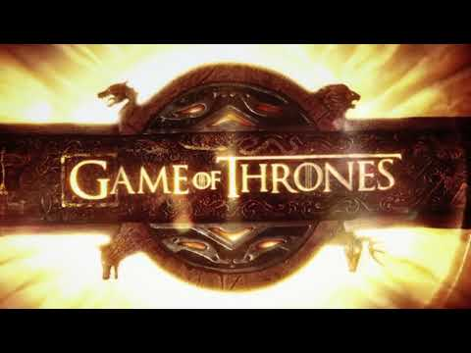

Slide 2
A Song of Json and Vader
Kevin McNalley (Team Lead)
Niki Patel
Jason Lee
Julienne Real
Notes:
Presentation Order:
Jules (+ Kevin)
Nikki
Kevin
Jason
Q&A

Slide 3
Motivation/Summary
Game of Thrones is a popular, highly-rated TV show known for being dark, gritty, and violent. We want to use VADER analysis on various aspects of Game of Thrones to look at sentiments per episode, season, how sentiment affected viewership, and more. Viewer sentiment will be measured through tweet analysis of viewers as well as of the official Game of Thrones twitter feed.
By doing so, we hoped to clean and compile sentiment analysis into graphs that are easily read and understood. By plotting how viewers feel during certain episodes and over seasons, we can potentially use this information to foresee trends and sell ad space during times the ads will be best received and the most people are watching. This could be useful for Game of Thrones in particular because the finale season airs in 2019.

Slide 4
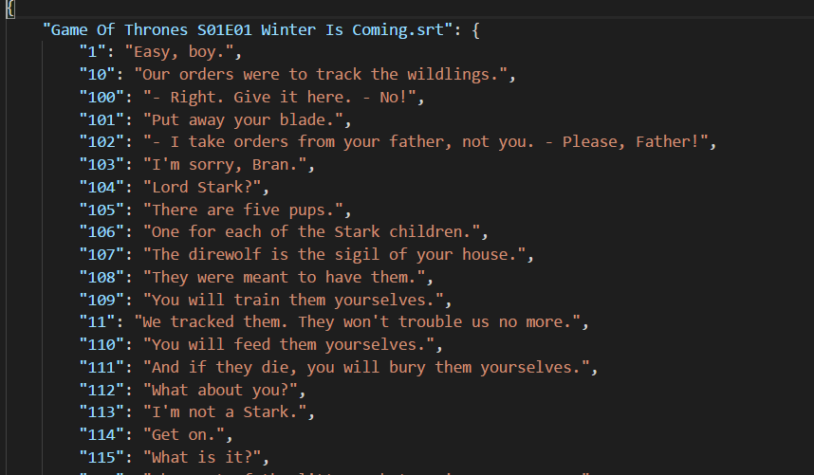
JSON File Sample

Slide 5
Questions and Data-Looking into IMDB
What episodes had higher ratings?
Building off of that question, which season was the most popular season?
To accomplish this, we used the imdb api(omdb)
Notes:
Nikita:For looking into the IMdb: Which season was the most popular season? What episodes tended to do better? These questions are relevant in the sense that it will show how much of an impact the sentiments of twitter analysis. Of course to accomplish this, we used the IMdb api to look into how the episodes were rated.

Slide 6
Data Cleanup Exploration-IMDB
Data cleanup for this was very straightforward overall. The only obstacles I had initially was converting the data I pulled into floating numbers and integers. But that was resolved using for loops.
Also, I had to make a separate dataframe for season 7 because I forgot that it had less episodes than the other seasons.

Slide 7
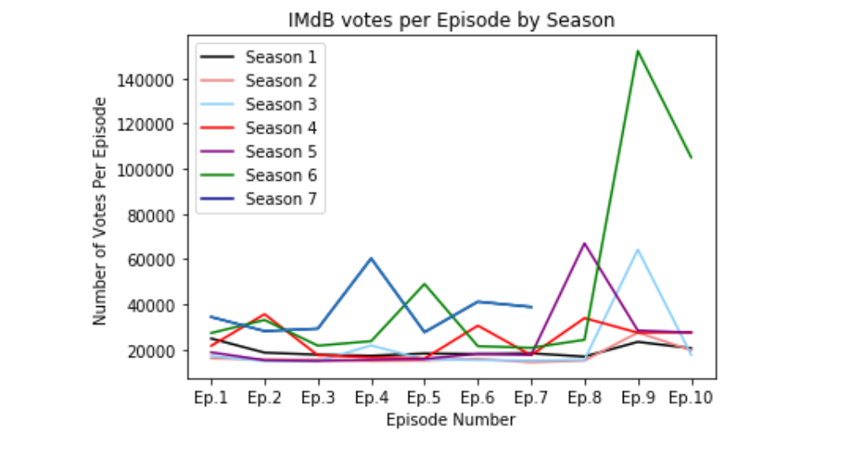
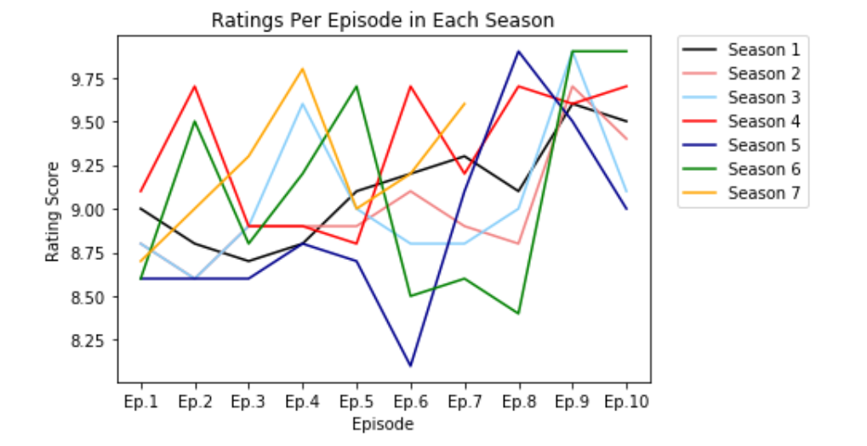
Data Analysis-IMDB
Notes:
Nikita: using the imdb api, I primarily pulled the imdb ratings and imdb votes to determine which seasons and episodes had the highest ratings. This led to wondering which was the most popular season. First, I organized the imdb ratings into a dataframe for each episode, in each season. I did the same thing for the imdb votes as well. After this, I plotted them into line graphs to see the trend of ratings and votes in each episode, by season. To answer which season was the most popular season, I took the average of each season’s ratings and votes and turned them into separate bar graphs.

Slide 8
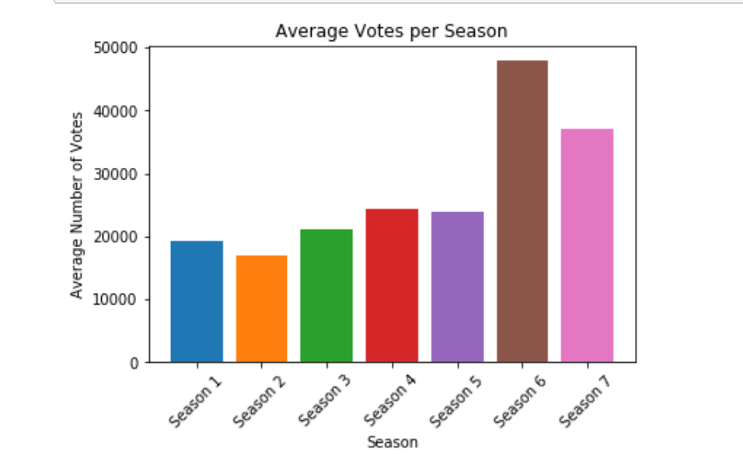
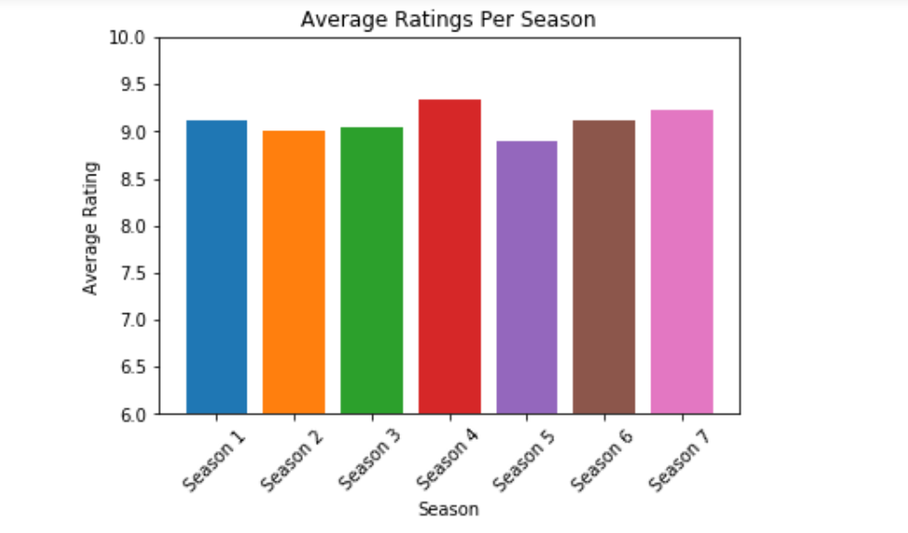
Data Analysis-IMDB cont...
Notes:
Nikita: using the imdb api, I primarily pulled the imdb ratings and imdb votes to determine which seasons and episodes had the highest ratings. This led to wondering which was the most popular season. First, I organized the imdb ratings into a dataframe for each episode, in each season. I did the same thing for the imdb votes as well. After this, I plotted them into line graphs to see the trend of ratings and votes in each episode, by season. To answer which season was the most popular season, I took the average of each season’s ratings and votes and turned them into separate bar graphs.

Slide 9
Discussion-IMDB
Based on the line graphs, ratings and votes were more higher towards the end of the season.
The bar graphs: The most popular season according the average number of votes was for season 6. But, season 4 had the highest average rating.
Notes:
Imdb: based on the line graphs, ratings and votes tended to be higher towards the end of the season. But for the most popular season, the average number of votes was for season 6. However, the highest average rating was for season 4. But crazy stuff happened during season 4! And also, when looking into the votes in general for season 4 and season 6, season 4 was around the ballpark as season 6. It was the last two episodes of season 6 that received very high votes because they were really well done. So the most popular season has a lot more factors than I considered.

Slide 10
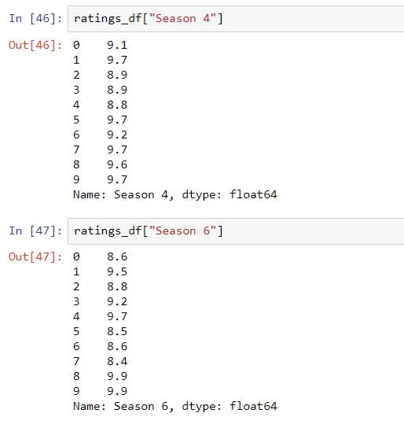
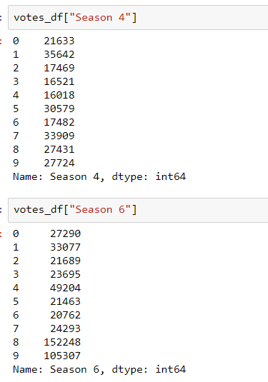
Discussion-IMDB

Slide 11
Post Mortem-IMDB
If I had more time, I would have looked into other sites that rate tv shows such as rotten tomatoes.
Another aspect I would have looked into would be to see if the trend of the seasons follows a similar trend as the episode trends.
Notes:
Imdb:I also know that imdb has the metascore ratings for movies but for some reason, I could not find the score for each episode of game of thrones. how do I truly know which one is the most popular season? What factors led into how the votes and reviews were accounted for? Also, does the season progression follow the same trend as the episode trends that we see? That’s what I would look into if I had more time.

Slide 12
Data Cleanup Exploration: VADER Analysis of GOT Seasons
Exploration was greatly aided by Kevin who found the scripts. The cleanup process was relatively clean and simple.
Some insights I had were realizing how much information a key’s value in a dictionary can hold. I assigned entire sentences to them and they were easy to access.
I found that paying money can get you access to older or more relevant/obscure data. Tweets retrieval was limited by how old the tweets were.
Many helpful guides exist to help you get APIs and other data. Don’t reinvent the wheel!
Notes:
Jules: Paying money can get you access to older/more relevant/better data. Tweets retrieval was limited by how old the tweets were. Many helpful guides exist to help you get APIs and other data--don’t reinvent the wheel.
Jason: Keyword searches through JSON files can only take you so far. The JSON script files don’t indicate which character speaks those lines.

Slide 13
Questions and Data: VADER Analysis of GOT Seasons
What were the VADER sentiment analysis scores for each season? For me, particularly season four.
There seemed to be no better way to get an objective view of the seasons than to use VADER analysis. Also, as someone who does not watch GOT this would give me a window into the sentiment of the show without having to watch it. A downside to relying on VADER might be the use of irony in the scripts or words from languages specific to GOT
Did these vary wildly?
For a show that is provocative and violent, the sentiment analysis did not vary widely from episode to episode, particuarly in season four. It seemed to maintain a uniform dark nature which is no doubt what fans expect. Certain compound scores dropped on particular episodes.
Did they have any correlation with viewers’ sentiment, which was explored via tweets?
Getting tweets was more difficult as older tweets were behind a paywall.
Notes:
Nikita:For looking into the IMdb: Which season was the most popular season? What episodes tended to do better? These questions are relevant in the sense that it will show how much of an impact the sentiments of twitter analysis. Of course to accomplish this, we used the IMdb api to look into how the episodes were rated.
Kevin:For Twitter: How do sentiments on tweets searched by #GameofThrones match with the episode air times? Which episodes have the highest correlation between episode and twitter compound score? Which have the lowest?
Kevin: Episode Analysis: How do the sentiments of each episode compare with each other? What trends, if any, are there? Do episodes known as big downers reflect this in their sentiments?
Jason: Does the number of deaths (of major characters) or ravens sent per episode have any effect on episode sentiment? If so how can we visualize the data to display those effects?
Jules: What were the VADER sentiment analysis scores for each season? For me, particularly season four. Did these vary wildly? Did they have any correlation with viewers’ sentiment, which was explored via tweets? For this I would need the season’s episode scripts, which Kevin found for us.

Slide 14
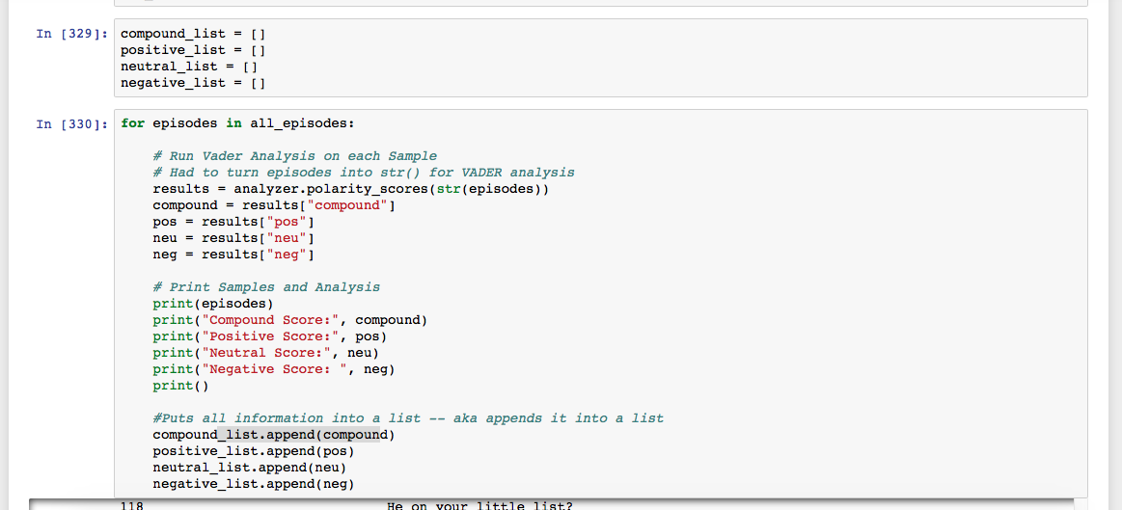
Data Analysis: VADER Analysis of GOT Seasons
For Season 4, I imported the season’s JSON file and put the episodes in a list. I then looped through these episodes and ran VADER analysis on each. I placed their sentiment scores into Compound, Positive, Negative, and Neutral lists.
Notes:
Nikita: using the imdb api, I primarily pulled the imdb ratings and imdb votes to determine which seasons and episodes had the highest ratings. This led to wondering which was the most popular season. First, I organized the imdb ratings into a dataframe for each episode, in each season. I did the same thing for the imdb votes as well. After this, I plotted them into line graphs to see the trend of ratings and votes in each episode, by season. To answer which season was the most popular season, I took the average of each season’s ratings and votes and turned them into separate bar graphs.
Jules: For Season 4, I imported the season’s JSON file and put the episodes in a list. I then looped through these episodes and ran VADER analysis on each. I placed their sentiment scores into Compound, Positive, Negative, and Neutral lists. I began to create a line graph which would visualize the suspected ups and downs in sentiment over the course of season four. I created a plot, mapped the scores, added titles and labels, and adjusted the grid. [Add some Jupyter screenshots]
Kevin: using the twitter api, I first pulled all of the tweets I could for the @GameofThrones account. Assuming that this would pull me tweets all the way back to the account creation in 2010, the script ran and collected about 1200 tweets, dating back to December of 2016. The official account also was lacking in tweets around the airtime of the episode, and there’s no way to search twitter for tweet time that I could find outside of using tweet IDs around the time you want to search for since_id and max_id. The final piece of joy I discovered is that the twitter search api is extremely limited in its scope, and only goes back one week.
Jason: While it would have been more interesting to compare the number of deaths per episode to the twitter sentiments done through Vader, this task proved to be difficult by the constraints discovered by Kevin. So instead, I decided to see if the overall sentiment of the transcript itself had been affected by various plot devices (ravens or messages) or the deaths of major characters. In doing the analysis, I fed in three data files (deaths, ravens, and allseasons) to incorporate into pandas DataFrames to produce a scatterplot depicting the effects (if any) that the count of ravens/deaths had on the sentiment of the episode transcript.

Slide 15
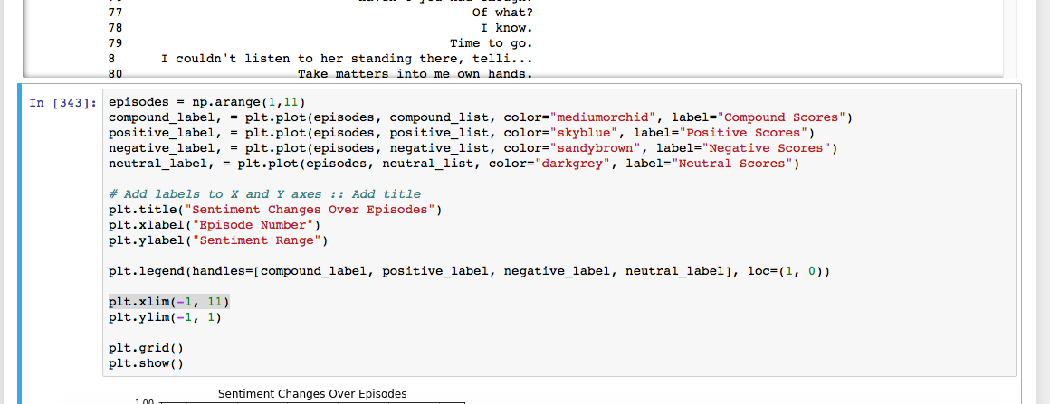
Data Analysis: VADER Analysis of GOT Seasons
I began to create a line graph which would visualize the suspected ups and downs in sentiment over the course of season four. I created a plot, mapped the scores, added titles and labels, and adjusted the grid. All group members did so for various seasons.
Notes:
Nikita: using the imdb api, I primarily pulled the imdb ratings and imdb votes to determine which seasons and episodes had the highest ratings. This led to wondering which was the most popular season. First, I organized the imdb ratings into a dataframe for each episode, in each season. I did the same thing for the imdb votes as well. After this, I plotted them into line graphs to see the trend of ratings and votes in each episode, by season. To answer which season was the most popular season, I took the average of each season’s ratings and votes and turned them into separate bar graphs.
Jules: For Season 4, I imported the season’s JSON file and put the episodes in a list. I then looped through these episodes and ran VADER analysis on each. I placed their sentiment scores into Compound, Positive, Negative, and Neutral lists. I began to create a line graph which would visualize the suspected ups and downs in sentiment over the course of season four. I created a plot, mapped the scores, added titles and labels, and adjusted the grid. [Add some Jupyter screenshots]
Kevin: using the twitter api, I first pulled all of the tweets I could for the @GameofThrones account. Assuming that this would pull me tweets all the way back to the account creation in 2010, the script ran and collected about 1200 tweets, dating back to December of 2016. The official account also was lacking in tweets around the airtime of the episode, and there’s no way to search twitter for tweet time that I could find outside of using tweet IDs around the time you want to search for since_id and max_id. The final piece of joy I discovered is that the twitter search api is extremely limited in its scope, and only goes back one week.
Jason: While it would have been more interesting to compare the number of deaths per episode to the twitter sentiments done through Vader, this task proved to be difficult by the constraints discovered by Kevin. So instead, I decided to see if the overall sentiment of the transcript itself had been affected by various plot devices (ravens or messages) or the deaths of major characters. In doing the analysis, I fed in three data files (deaths, ravens, and allseasons) to incorporate into pandas DataFrames to produce a scatterplot depicting the effects (if any) that the count of ravens/deaths had on the sentiment of the episode transcript.

Slide 16
Discussion: VADER Analysis of GOT Seasons
The information I found about Game of Thrones was all new to me. I don’t watch the show, so I had no idea what the sentiment was during certain episodes and seasons.
However, I did know that it was a dark show that people reacted strongly to, so I suspected the sentiment would be MORE negative than it was. This assumption seemed to be incorrect.
VADER of the episode scripts don’t tell me what viewers think, but I was able to get a feel for the sentiment of the episode. VADER analysis can be useful if you’re working with a subject you’re unfamiliar about. In our scenario where we’re selling ad space, you want to be able to tailor your ads regardless of whether or not you’re a hardcore fan or brand new to GOT.
Notes:
Imdb: based on the line graphs, ratings and votes tended to be higher towards the end of the season. But for the most popular season, the average number of votes was for season 4. However, the highest average rating was for season 6 because the last two episode for season 6 was honestly amazing. But crazy stuff happened during season 4! And also, when looking into the ratings in general for season 4 and season 6, season 4 had more consistent higher ratings than season 6. So the most popular season has a lot more factors than I considered.
Jules: As for me, what I found was all new. I don’t watch the show, so I had no idea what the sentiment was during certain episodes and seasons. VADER of the episode scripts don’t tell me what other people think, but I was able to get a feel for the sentiment of the episode. VADER analysis can be useful if you’re working with a subject you’re unfamiliar about. In our scenario where we’re selling ad space, you want to be able to tailor your ads regardless of whether or not you’re a hardcore fan or brand new to GOT.
Kevin: I was surprised to see the sentiment scores of certain episodes I remembered with strong positive or negative feelings. Of course, this is because we’re only looking at a single aspect of a very complicated production, as lighting, audio, weather, and so much more contribute to overall mood.
Jason: Upon performing the analysis, I found that there were little to no relationships between the count of ravens/deaths in each episode to the overall sentiment of the episode script. The script contained a minimal amount of mentions for ‘ravens’ (compared to the books, one would assume) which made it difficult to establish a conclusion; but I did take note that in episodes with more than six high profile character deaths, the overall sentiment was always negative.

Slide 17
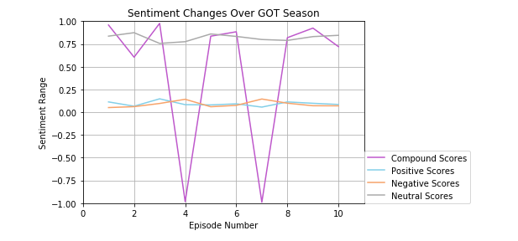
Discussion: VADER Analysis of GOT Seasons
These findings showed that, for example in season four, the compound score varied widely.
Compound scores pretty accurately reflected the average of the scores, ie. when episodes were highly positive or negative, the compound score reflects this
Season four in its entirety didn’t seem to vary much, there were no large fluctuations in the positive, neutral, or negative scores
Notes:
Imdb: based on the line graphs, ratings and votes tended to be higher towards the end of the season. But for the most popular season, the average number of votes was for season 4. However, the highest average rating was for season 6 because the last two episode for season 6 was honestly amazing. But crazy stuff happened during season 4! And also, when looking into the ratings in general for season 4 and season 6, season 4 had more consistent higher ratings than season 6. So the most popular season has a lot more factors than I considered.
Jules: As for me, what I found was all new. I don’t watch the show, so I had no idea what the sentiment was during certain episodes and seasons. VADER of the episode scripts don’t tell me what other people think, but I was able to get a feel for the sentiment of the episode. VADER analysis can be useful if you’re working with a subject you’re unfamiliar about. In our scenario where we’re selling ad space, you want to be able to tailor your ads regardless of whether or not you’re a hardcore fan or brand new to GOT.
Kevin: I was surprised to see the sentiment scores of certain episodes I remembered with strong positive or negative feelings. Of course, this is because we’re only looking at a single aspect of a very complicated production, as lighting, audio, weather, and so much more contribute to overall mood.
Jason: Upon performing the analysis, I found that there were little to no relationships between the count of ravens/deaths in each episode to the overall sentiment of the episode script. The script contained a minimal amount of mentions for ‘ravens’ (compared to the books, one would assume) which made it difficult to establish a conclusion; but I did take note that in episodes with more than six high profile character deaths, the overall sentiment was always negative.

Slide 18
Post Mortem: VADER Analysis of GOT Seasons
The difficulties that arose were finding tweets, finding information was difficult and you needed a premium membership to get some older tweets. What was good was that there were other people already interested in this pop culture topic, so APIs were easy to find.
Other topics if we had more time: We started our project thinking we could focus on another topic and crime, and someone thought it’d be fun to track and analyze the crimes in GOT. That would be very entertaining to research.
Notes:
Imdb: how do I truly know which one is the most popular season? After I recapped the plots for season 4 and season 6, season 6 received the high ratings towards the end because the last two episodes were absolutely amazing. Also, does the season progression follow the same trend as the episode trends that we see? That’s what I would look into if I had more time. Also, the number of votes can truly impact the data.
Kevin: Twitter: welp. In an effort to try to scrape something together, I came across some interesting questions about twitter I might want to look into later, for example if there is a superior tweeting pattern or reasoning behind number of times mentioning other users or...
Jason: See if there is a way to incorporate a gui (i.e. a map of all the ravens being sent to and from different locations) and make it interactive.

Slide 19
Kevin’s Stuff
Season Script Analysis
Twitter Adventures
Initial questions -> the issues -> what to do -> what I ended up with
Things to show:
https://github.com/totopi/Retro-Fireballs/blob/kevin/analysis/analysis.ipynb
https://github.com/totopi/Retro-Fireballs/blob/kevin/analysis/Tweepy.ipynb
https://github.com/totopi/Retro-Fireballs/blob/kevin/analysis/officialtwitter.ipynb
https://github.com/totopi/Retro-Fireballs/blob/kevin/analysis/TweepyGoTNetwork.ipynb

Slide 20
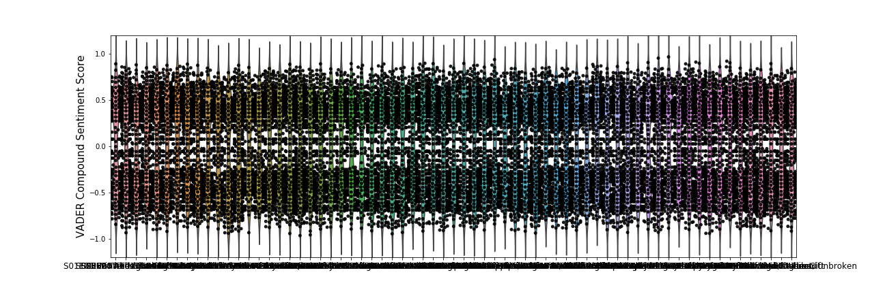
A Plot of Every Episode’s Sentiments
Notes:
Don’t graph them all at once!

Slide 21
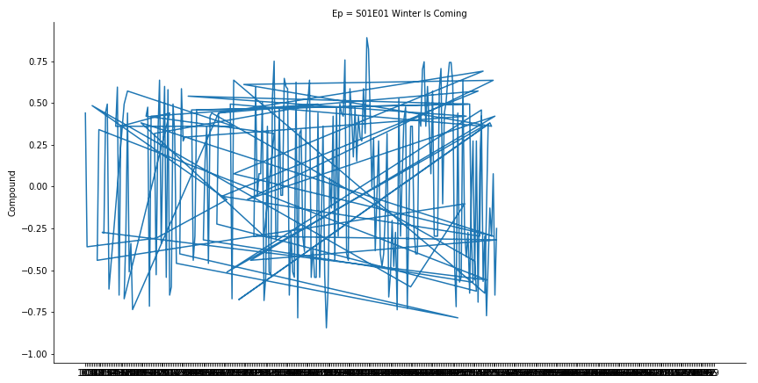
Notes:
Choosing the correct graph type is important

Slide 22
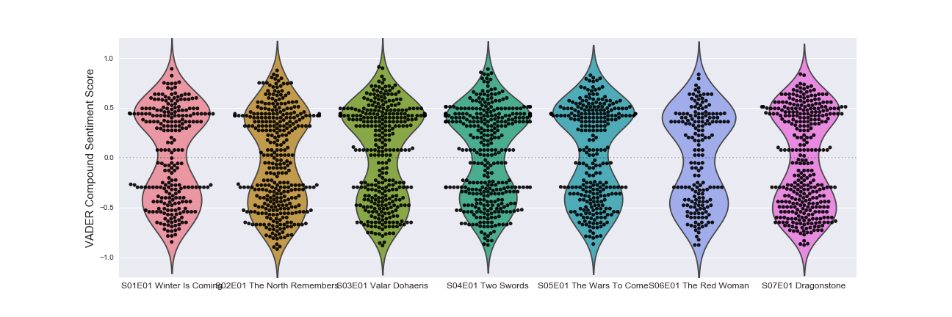
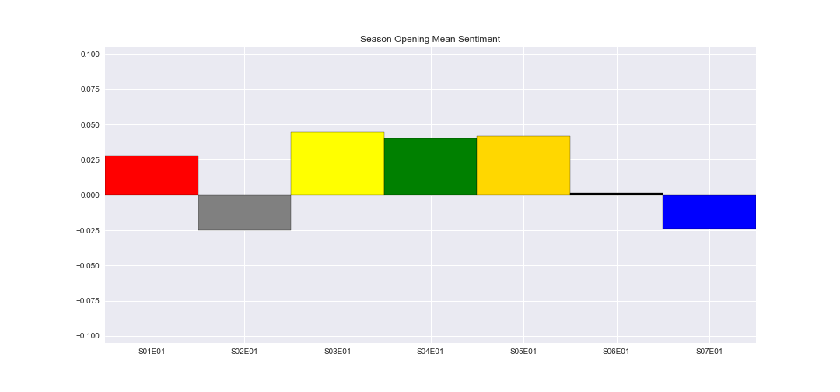
Notes:
Season opener episodes: polarity is generally closer to zero, but positiveish outlook to begin the season in general

Slide 23
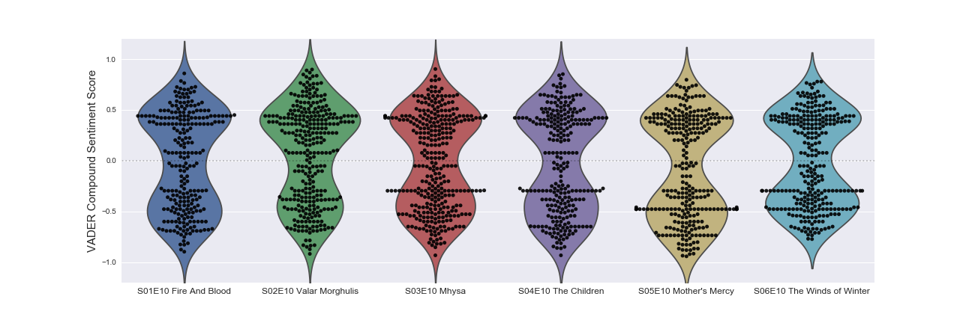
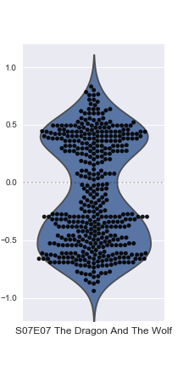
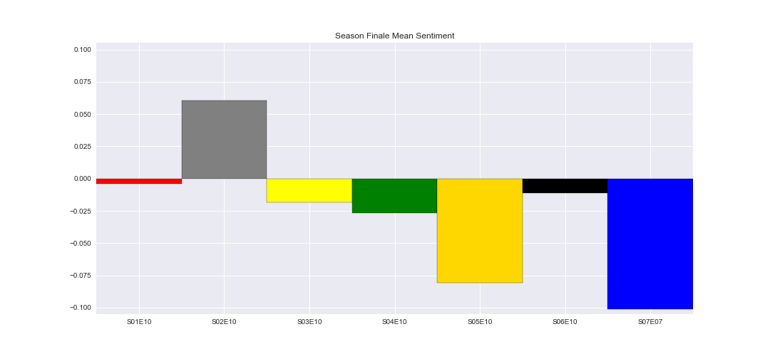
Notes:
Season Finales: Tend to end more negatively, aside from season 2

Slide 24
Questions and Data: Tweepy Analysis
How do tweets with #GameofThrones during specific episodes sentiment scores compare to the episode?
Which episodes have the highest correlation between episode and twitter compound score? Which have the lowest?
Data
https://www.kaggle.com/gunnvant/game-of-thrones-srt
Tweepy
Wait, what can I actually do?
Notes:
Kevin:For Twitter: How do sentiments on tweets searched by #GameofThrones match with the episode air times? Which episodes have the highest correlation between episode and twitter compound score? Which have the lowest?
Kevin: Episode Analysis: How do the sentiments of each episode compare with each other? What trends, if any, are there? Do episodes known as big downers reflect this in their sentiments?
Jason: Does the number of deaths (of major characters) or ravens sent per episode have any effect on episode sentiment? If so how can we visualize the data to display those effects?

Slide 25
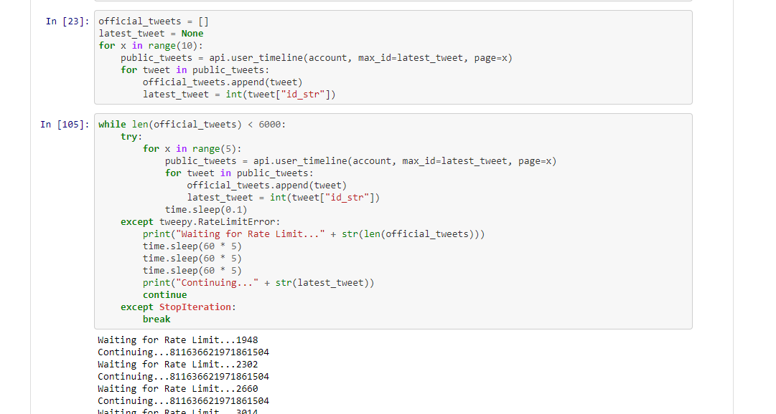
Data Cleanup Exploration
https://github.com/totopi/Retro-Fireballs/blob/kevin/analysis/Tweepy.ipynb
Twitter API Limitations Discovered
Search: 1 week
User Timeline: ~16 months

Slide 26
Data Cleanup, Exploration, Analysis
https://github.com/totopi/Retro-Fireballs/blob/master/Presentation/officialtwitter.ipynb
https://github.com/totopi/Retro-Fireballs/blob/master/Presentation/TweepyGoTNetwork.ipynb
https://github.com/totopi/Retro-Fireballs/blob/master/Presentation/Graphs.ipynb
What can I do?
Find new questions, Do what I can with the data
What does a popular programs social network look like?
How do sentiments vary between Official Twitter accounts and the general twittering populace?
Notes:
* Discuss any problems that arose after exploring the data, and how you resolved them
* Present and discuss interesting figures developed during exploration, ideally with the help of Jupyter Notebook

Slide 27
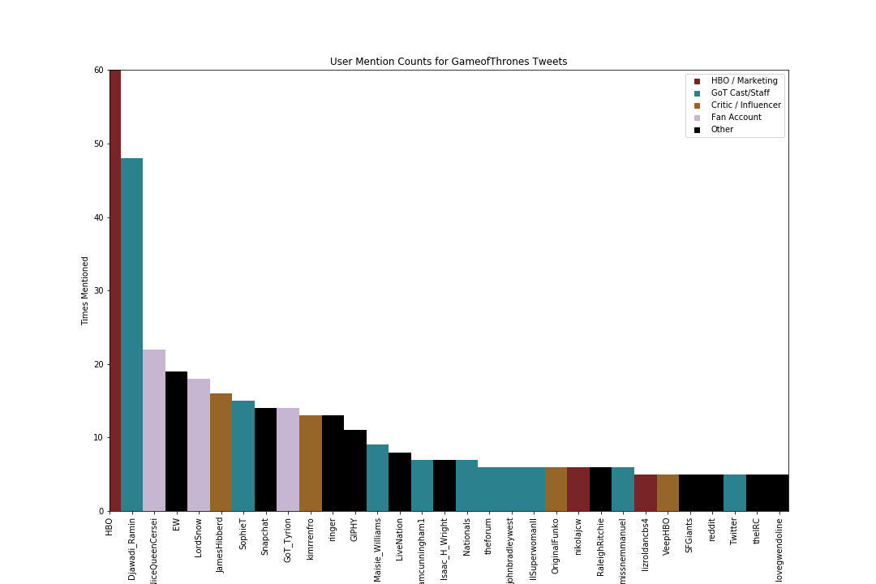
Notes:
Count of times user is mentioned by @GameofThrones account, GoT (own account) 300+, HBO nearly 200, everyone else

Slide 28
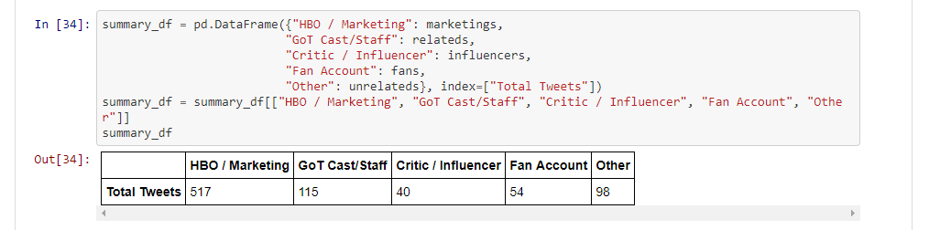

Slide 29
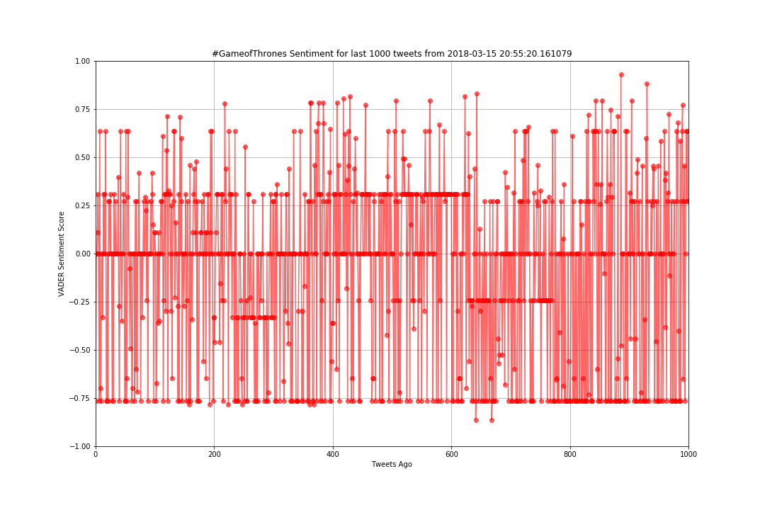
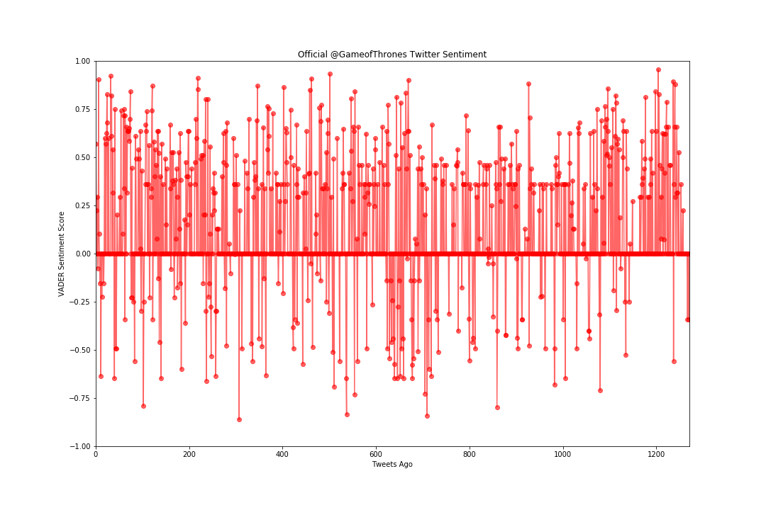
General Twitter Users vs Official Accounts
Notes:
Left: Search for #GameofThrones, last 1000 tweet result’s compound sentiment score
Right: @GameofThrones last 12xx tweet’s compound sentiment score

Slide 30
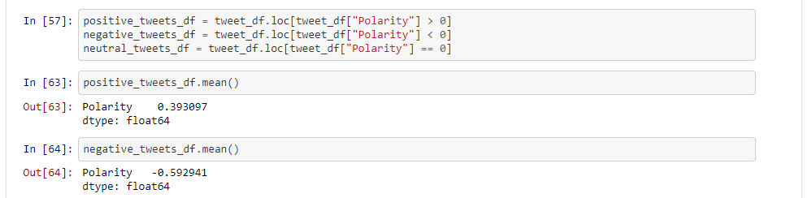

Slide 31
Ravens & Deaths
Motivation & Questions
Explore the ways in which the episode sentiment (Vader) had been affected by the occurrence of certain story developments.
Ravens- GoT uses ravens to communicate messages from character to character; for the writers, these plot devices serve as transition place-keepers to move the main story along. For the purposes of analysis, in the event a raven is sent, does this have an impact on overall episode sentiment (good/bad news)?
Deaths- GoT is infamous for its gratuitous violence, how will the deaths of the main characters affect the overall sentiment for each episode?
Notes:
Does the number of deaths (of major characters) or ravens sent per episode have any effect on episode sentiment? If so how can we visualize the data to display those effects?

Slide 32
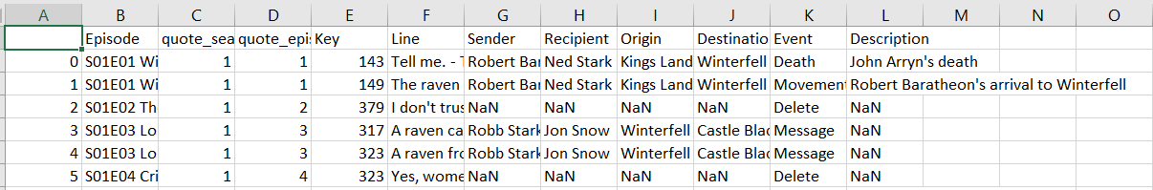
Ravens & Deaths
Data Exploration & Cleaning
The following datasets were used to perform my analysis:
https://www.kaggle.com/gunnvant/game-of-thrones-srt (JSON script for all 7 seasons)
https://data.world/aendrew/game-of-thrones-deaths (CSV file for major character deaths)
A Ravens CSV file I created with python that captured the keyword hits of (‘raven’,‘message’) along with the episode name.
Notes:
Keyword searches through JSON files can only take you so far. The JSON script files don’t indicate which character speaks those lines.

Slide 33
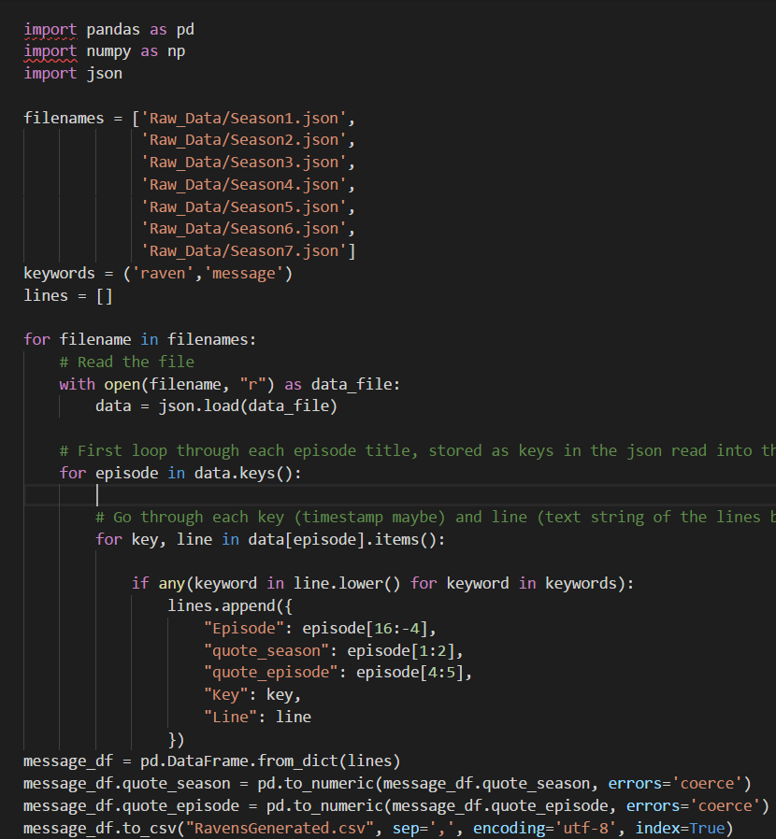
Ravens & Deaths
Data Exploration & Cleaning Continued
To perform a keyword search in JSON:
Create a list type (tuple)
Insert a conditional statement in our for loop:
if any(keyword in line.lower() for keyword in keywords):
Completing the other columns (Sender, Recipient, Origin, Destination) was performed manually as there was no indication in the JSON script of which character is saying the line. (very tedious)

Slide 34
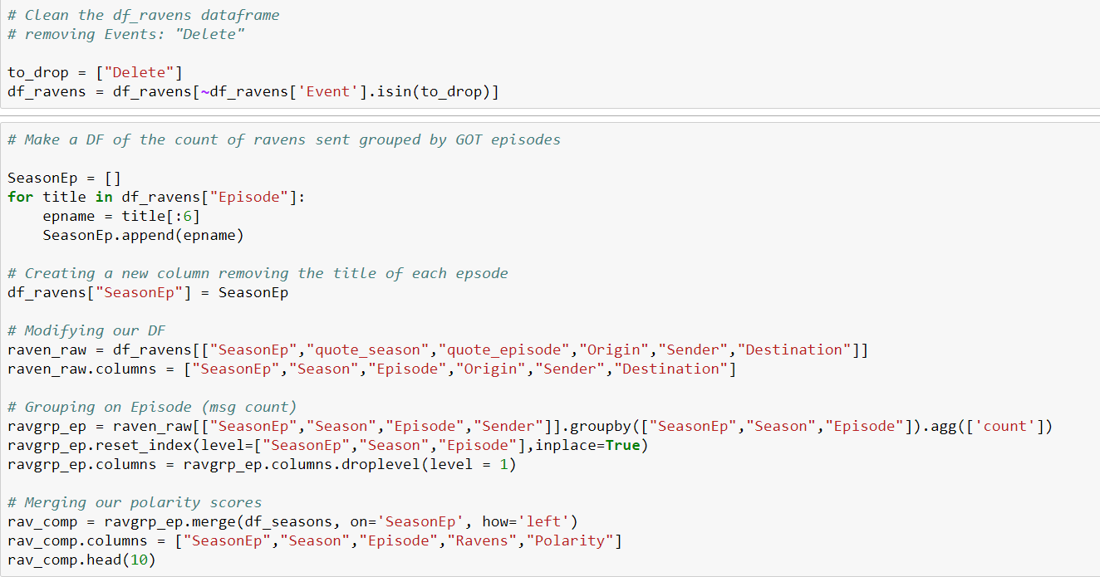
Ravens & Deaths (Data Analysis in Jupyter Notebook)
Data Analysis
Notes:
While it would have been more interesting to compare the number of deaths per episode to the twitter sentiments done through Vader, this task proved to be difficult by the constraints discovered by Kevin. So instead, I decided to see if the overall sentiment of the transcript itself had been affected by various plot devices (ravens or messages) or the deaths of major characters. In doing the analysis, I fed in three data files (deaths, ravens, and allseasons) to incorporate into pandas DataFrames to produce a scatterplot depicting the effects (if any) that the count of ravens/deaths had on the sentiment of the episode transcript.

Slide 35
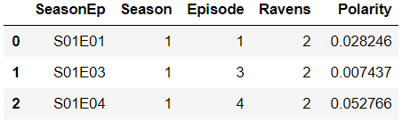
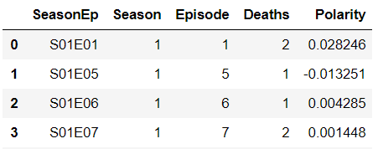
Ravens & Deaths
Ravens DataFrame
Deaths DataFrame

Slide 36
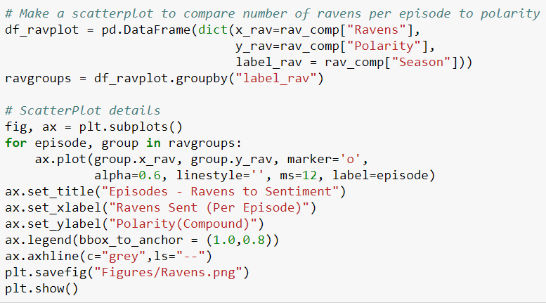
Ravens & Deaths
Pandas for Ravens plot:
Similar to our Death plot.

Slide 37
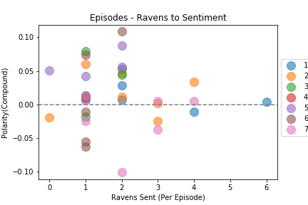
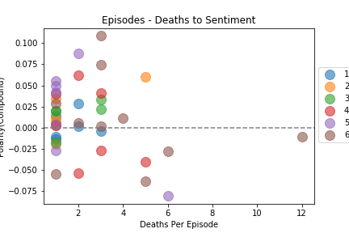
Ravens & Deaths
Notes:
Jason: In order to see if the occurrence of character deaths or plot developments (where ravens are used to transition between scenes) had any impact on the sentiment of the episode script, I made scatter plots depicting my x variable (counts of our independent variable [ravens, deaths]) against the mean compound score of that particular episode. The hypothesis was to see if there were any discernible relationships between our two x and y axis variables. Each plot represents the available episode which is grouped by the season (each episode in the same season is the same color). As you can see, the findings are inconclusive with the sentiment score varying independent of death/raven counts.

Slide 38
Ravens & Deaths
Summary (Findings)
Does the frequency of ravens sent per episode have an impact on the episode sentiment?
Not really. The outlier from S01E06 (Tyrion’s incarceration in the Vale).
Does the frequency of deaths (to significant characters) have an impact on episode sentiment?
Again difficult to say. However note that for episodes with more than six character deaths, the sentiment is negative. Season six is very brutal to our characters.
Notes:
Jason: Upon performing the analysis, I found that there were little to no relationships between the count of ravens/deaths in each episode to the overall sentiment of the episode script. The script contained a minimal amount of mentions for ‘ravens’ (compared to the books, one would assume) which made it difficult to establish a conclusion; but I did take note that in episodes with more than six high profile character deaths, the overall sentiment was always negative.

Slide 39
Ravens & Deaths
Post-Mortem
Data Cleanup: (most difficult step), the JSON script did not indicate which character speaks the lines so in order to find the [Sender,Recipient,Origin,Destination,Description]
entries, I had to read (quite literally) between the lines to populate the entries.
If there was more time to analyse the data, I would have like to find out:
Which characters sent the most ravens and for what purpose?
How do characters die in GoT; what is the leading cause of death?
Is there an API for the novels? Can I do the analysis on that data to find the differences between the book and the tv drama?
Notes:
Jason: Upon performing the analysis, I found that there were little to no relationships between the count of ravens/deaths in each episode to the overall sentiment of the episode script. The script contained a minimal amount of mentions for ‘ravens’ (compared to the books, one would assume) which made it difficult to establish a conclusion; but I did take note that in episodes with more than six high profile character deaths, the overall sentiment was always negative.

Slide 40
Q&A: Open Floor

Slide 41
Questions and Data
Describe the questions you asked, and _why_ you asked them…
Elaborate on the questions you asked, describing what kinds of data you needed to answer them, and where you found it
Data
https://www.kaggle.com/gunnvant/game-of-thrones-srt
Tweepy
Imdb
Notes:
Nikita:For looking into the IMdb: Which season was the most popular season? What episodes tended to do better? These questions are relevant in the sense that it will show how much of an impact the sentiments of twitter analysis. Of course to accomplish this, we used the IMdb api to look into how the episodes were rated.
Kevin:For Twitter: How do sentiments on tweets searched by #GameofThrones match with the episode air times? Which episodes have the highest correlation between episode and twitter compound score? Which have the lowest?
Kevin: Episode Analysis: How do the sentiments of each episode compare with each other? What trends, if any, are there? Do episodes known as big downers reflect this in their sentiments?
Jason: Does the number of deaths (of major characters) or ravens sent per episode have any effect on episode sentiment? If so how can we visualize the data to display those effects?
Jules: What were the VADER sentiment analysis scores for each season? For me, particularly season four. Did these vary wildly? Did they have any correlation with viewers’ sentiment, which was explored via tweets? For this I would need the season’s episode scripts, which Kevin found for us.

Slide 42
Data Cleanup Exploration
* Describe the exploration and cleanup process
* Discuss insights you had while exploring the data that you didn't anticipate
* Discuss any problems that arose after exploring the data, and how you resolved them
* Present and discuss interesting figures developed during exploration, ideally with the help of Jupyter Notebook
Notes:
Jules: Paying money can get you access to older/more relevant/better data. Tweets retrieval was limited by how old the tweets were. Many helpful guides exist to help you get APIs and other data--don’t reinvent the wheel.
Jason: Keyword searches through JSON files can only take you so far. The JSON script files don’t indicate which character speaks those lines.

Slide 43
Data Analysis
* Discuss the steps you took to analyze the data and answer each question you asked in your proposal
* Present and discuss interesting figures developed during analysis, ideally with the help of Jupyter Notebook
Do we want to have a slide each and maybe explain what we did individually?
Notes:
Nikita: using the imdb api, I primarily pulled the imdb ratings and imdb votes to determine which seasons and episodes had the highest ratings. This led to wondering which was the most popular season. First, I organized the imdb ratings into a dataframe for each episode, in each season. I did the same thing for the imdb votes as well. After this, I plotted them into line graphs to see the trend of ratings and votes in each episode, by season. To answer which season was the most popular season, I took the average of each season’s ratings and votes and turned them into separate bar graphs.
Jules: For Season 4, I imported the season’s JSON file and put the episodes in a list. I then looped through these episodes and ran VADER analysis on each. I placed their sentiment scores into Compound, Positive, Negative, and Neutral lists. I began to create a line graph which would visualize the suspected ups and downs in sentiment over the course of season four. I created a plot, mapped the scores, added titles and labels, and adjusted the grid. [Add some Jupyter screenshots]
Kevin: using the twitter api, I first pulled all of the tweets I could for the @GameofThrones account. Assuming that this would pull me tweets all the way back to the account creation in 2010, the script ran and collected about 1200 tweets, dating back to December of 2016. The official account also was lacking in tweets around the airtime of the episode, and there’s no way to search twitter for tweet time that I could find outside of using tweet IDs around the time you want to search for since_id and max_id. The final piece of joy I discovered is that the twitter search api is extremely limited in its scope, and only goes back one week.
Jason: While it would have been more interesting to compare the number of deaths per episode to the twitter sentiments done through Vader, this task proved to be difficult by the constraints discovered by Kevin. So instead, I decided to see if the overall sentiment of the transcript itself had been affected by various plot devices (ravens or messages) or the deaths of major characters. In doing the analysis, I fed in three data files (deaths, ravens, and allseasons) to incorporate into pandas DataFrames to produce a scatterplot depicting the effects (if any) that the count of ravens/deaths had on the sentiment of the episode transcript.

Slide 44
Discussion
Discuss your findings. Did you find what you expected to find?
If not, why not?
What inferences or general conclusions can you draw from your analysis?
Summarize your conclusions. This should include a numerical summary (i.e., what data did your analysis yield), as well as visualizations of that summary (plots of the final analysis data)
Discuss the implications of your findings. This is where you get to have an open-ended discussion about what your findings "mean".
Notes:
Imdb: based on the line graphs, ratings and votes tended to be higher towards the end of the season. But for the most popular season, the average number of votes was for season 4. However, the highest average rating was for season 6 because the last two episode for season 6 was honestly amazing. But crazy stuff happened during season 4! And also, when looking into the ratings in general for season 4 and season 6, season 4 had more consistent higher ratings than season 6. So the most popular season has a lot more factors than I considered.
Jules: As for me, what I found was all new. I don’t watch the show, so I had no idea what the sentiment was during certain episodes and seasons. VADER of the episode scripts don’t tell me what other people think, but I was able to get a feel for the sentiment of the episode. VADER analysis can be useful if you’re working with a subject you’re unfamiliar about. In our scenario where we’re selling ad space, you want to be able to tailor your ads regardless of whether or not you’re a hardcore fan or brand new to GOT.
Kevin: I was surprised to see the sentiment scores of certain episodes I remembered with strong positive or negative feelings. Of course, this is because we’re only looking at a single aspect of a very complicated production, as lighting, audio, weather, and so much more contribute to overall mood.
Jason: Upon performing the analysis, I found that there were little to no relationships between the count of ravens/deaths in each episode to the overall sentiment of the episode script. The script contained a minimal amount of mentions for ‘ravens’ (compared to the books, one would assume) which made it difficult to establish a conclusion; but I did take note that in episodes with more than six high profile character deaths, the overall sentiment was always negative.

Slide 45
Post Mortem
* Discuss any difficulties that arose, and how you dealt with them
* Discuss any additional questions that came up, but which you didn't have time to answer:
What would you research next, if you had two more weeks?
Notes:
Imdb: how do I truly know which one is the most popular season? After I recapped the plots for season 4 and season 6, season 6 received the high ratings towards the end because the last two episodes were absolutely amazing. Also, does the season progression follow the same trend as the episode trends that we see? That’s what I would look into if I had more time. Also, the number of votes can truly impact the data.
Kevin: Twitter: welp. In an effort to try to scrape something together, I came across some interesting questions about twitter I might want to look into later, for example if there is a superior tweeting pattern or reasoning behind number of times mentioning other users or...
Jason: See if there is a way to incorporate a gui (i.e. a map of all the ravens being sent to and from different locations) and make it interactive.

